Slide 1

Data-Driven Solutions for SDG 3: Good Health and Well-being
This presentation outlines a data-driven solution to address healthcare accessibility challenges in rural areas, focusing on improving service delivery and promoting good health and well-being.

Slide 2

Healthcare Accessibility Challenges in Rural Areas
1
Limited Infrastructure
2
Transportation Barriers
Rural areas often lack sufficient healthcare infrastructure, including hospitals, clinics, and qualified medical personnel.
Distance and poor road conditions make it difficult for rural residents to access healthcare facilities.
3
Financial Constraints
4
Lack of Awareness
Limited income and lack of healthcare insurance pose significant financial burdens for rural communities.
Rural populations may have limited knowledge about available healthcare services and resources.

Slide 3
Leveraging Data to Inform Decisions
Patient Data
Geographic Information Systems (GIS)
Data Analytics
Collecting patient data allows for better understanding of health needs, disease prevalence, and service utilization patterns.
Analyzing data patterns identifies healthcare gaps, predicts disease outbreaks, and informs interventions to improve health outcomes.
Mapping health resources and patient locations enables optimization of healthcare delivery networks and resource allocation.

Slide 4
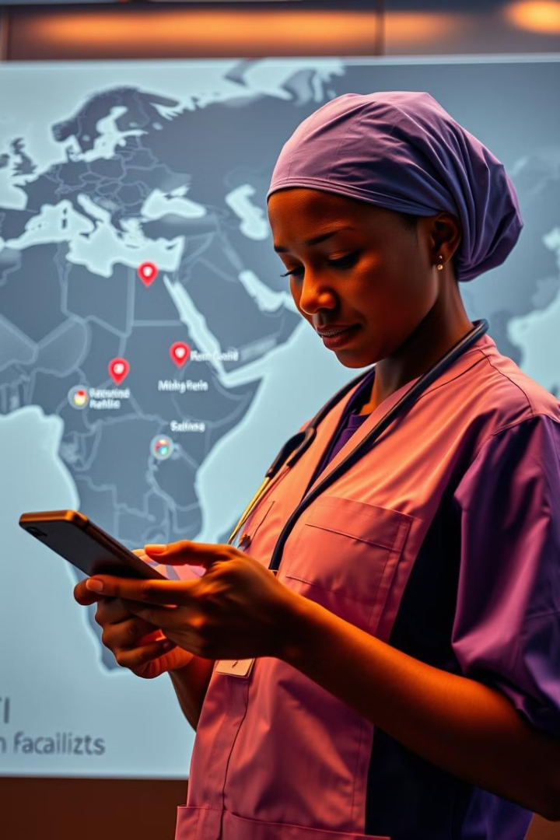



Improving Service Delivery through Data-Driven Insights
Targeted Interventions
Identify high-risk populations and implement tailored interventions based on data-driven insights.
Optimized Resource Allocation
Allocate resources effectively based on need, ensuring adequate staffing and supplies at rural health facilities.
Improved Patient Engagement
Develop digital health tools to facilitate communication, provide remote consultations, and empower patient self-management.

Slide 5

Project Objectives and Scope
Improve Healthcare Accessibility
Increase Service Utilization
Enhance access to quality healthcare services for rural communities by leveraging data-driven solutions.
Encourage greater utilization of healthcare services by addressing barriers and promoting proactive health management.
Improve Health Outcomes
Contribute to better health outcomes for rural populations by optimizing service delivery and addressing health disparities.

Slide 6

Data Collection and Analysis Methodology
1
Data Sources
Identify relevant data sources, including patient records, health facility data, and community surveys.
2
Data Cleaning and Integration
Clean and standardize data to ensure accuracy and consistency for analysis and reporting.
3
Statistical Analysis
Apply statistical techniques to identify trends, correlations, and key insights from the data.
4
Data Visualization
Present data findings in a clear and understandable format to inform decision-making and interventions.

Slide 7
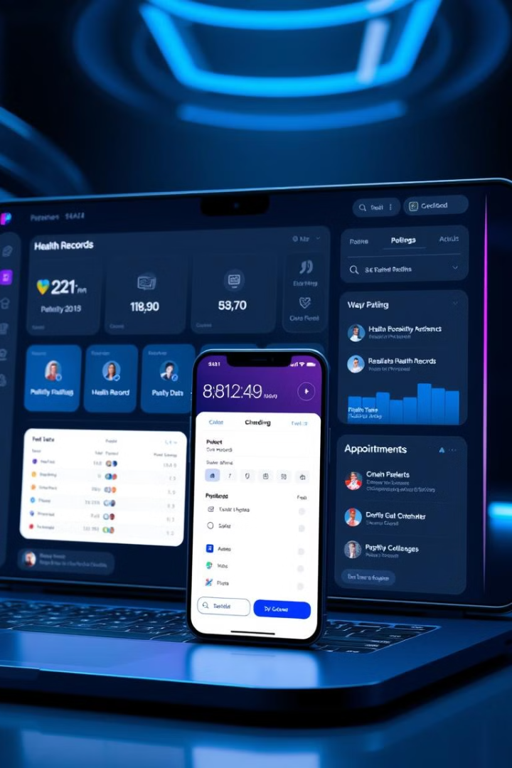




Innovative Technology Integration
Mobile Health Apps
Telemedicine Platforms
Develop mobile applications to facilitate patient access to healthcare information and services.
Implement telemedicine technologies to connect rural patients with healthcare providers remotely.
Artificial Intelligence (AI)
Cloud-Based Data Storage
Utilize AI algorithms to analyze data, predict health risks, and personalize healthcare interventions.
Securely store and manage patient data on a cloud platform for accessibility and scalability.

Slide 8

Stakeholder Engagement and Collaboration
Government Agencies
Collaborate with local and national health ministries to integrate the solution into existing healthcare systems.
Healthcare Providers
Engage healthcare professionals to provide input on data needs, technology adoption, and service delivery.
Community Leaders
Involve community leaders to ensure the solution is culturally relevant and meets the specific needs of rural communities.
Non-Governmental Organizations (NGOs)
Partner with NGOs to leverage their expertise in community outreach, health education, and resource mobilization.

Slide 9

Measurable Outcomes and Impact
1
Increased Healthcare Access
2
Improved Health Outcomes
Track the number of patients accessing healthcare services in rural areas.
Monitor key health indicators, such as mortality rates, disease prevalence, and vaccination coverage.
3
Enhanced Patient Satisfaction
4
Cost Savings
Measure patient satisfaction with the quality and accessibility of healthcare services.
Analyze the cost-effectiveness of the solution by comparing healthcare expenditures before and after implementation.

Slide 10
Sustainability and Scalability of the Solution
Long-Term Sustainability
Scalability Across Regions
Continuous Improvement
Develop a sustainable financing model to ensure the ongoing operation and maintenance of the solution.
Design the solution to be adaptable and scalable to meet the needs of other rural communities.
Implement a system for ongoing data collection, analysis, and evaluation to ensure continuous improvement of the solution.

Slide 11
Our ask
We ask for support in securing funding for the implementation and maintenance of the solution, as well as technical expertise in developing and monitoring the necessary data collection systems. With your support, we can ensure the long-term sustainability, scalability, and impact of this healthcare initiative in rural communities.

Slide 12
Our team
consists of experienced healthcare professionals, data analysts, and project managers who are dedicated to the success of this initiative. We have a proven track record of implementing similar healthcare solutions in underserved communities and are confident in our ability to deliver positive outcomes. With your partnership, we can make a lasting impact on the accessibility and quality of healthcare services in rural areas.

